Slide 1
Chapter 3 - Computer Software
System Software

Slide 2
Learning Objectives
Explain system software and operating systems
Identify operating systems for desktop PCs
Identify operating systems for handheld PCs and larger computers
Discuss utility programs

Slide 3
System Software
The programs that control and maintain the operation of the computer and its devices
The two parts of system software are the Operating System (OS) and utility programs.
Operating system (OS) (sometimes called the platform) coordinates all activities among computer hardware resources, applications and the user.
Utility programs are used to maintain the health of the operating system.

Slide 4
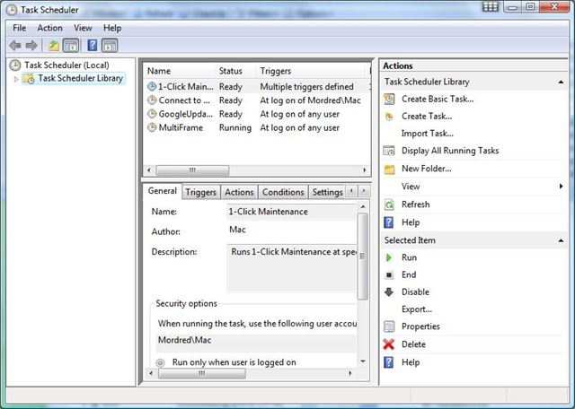
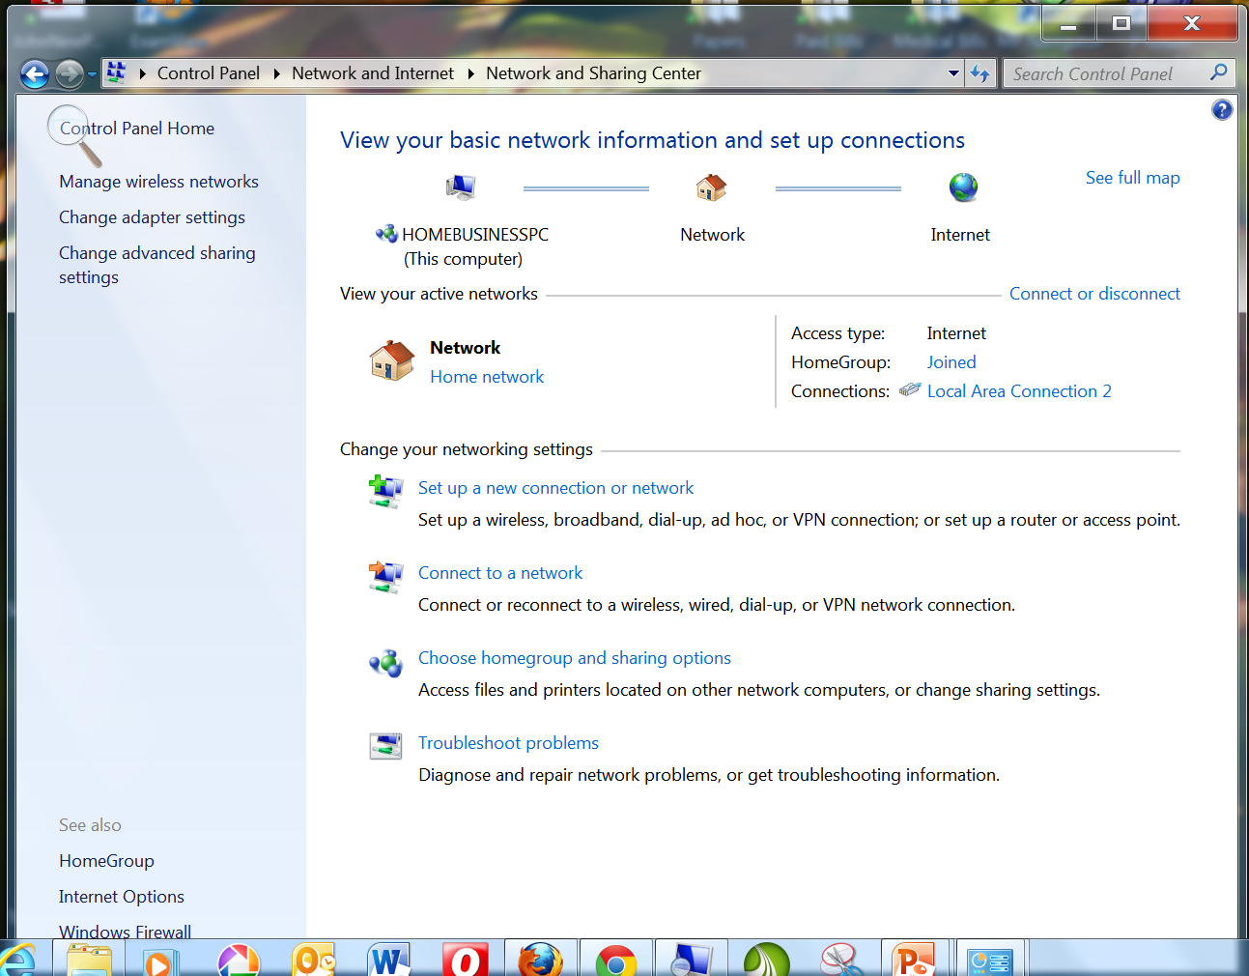
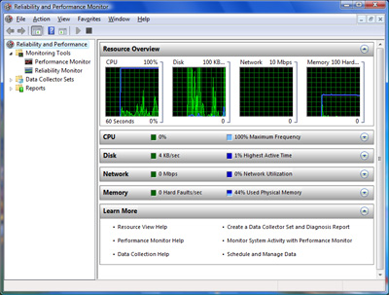
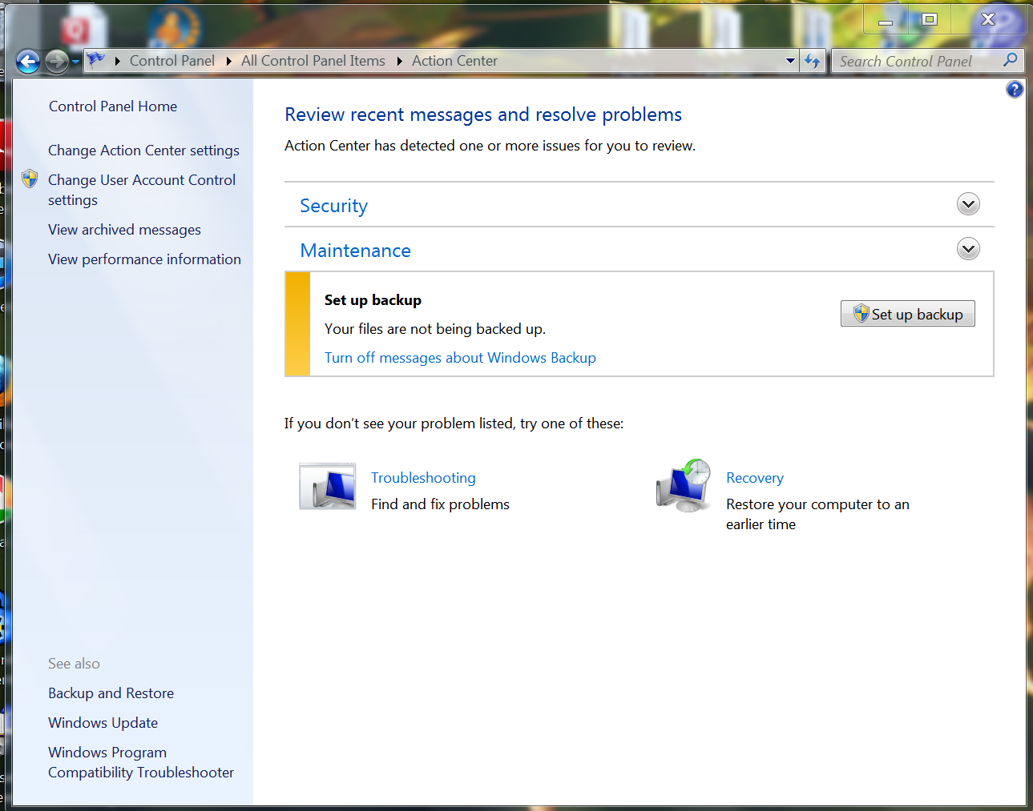
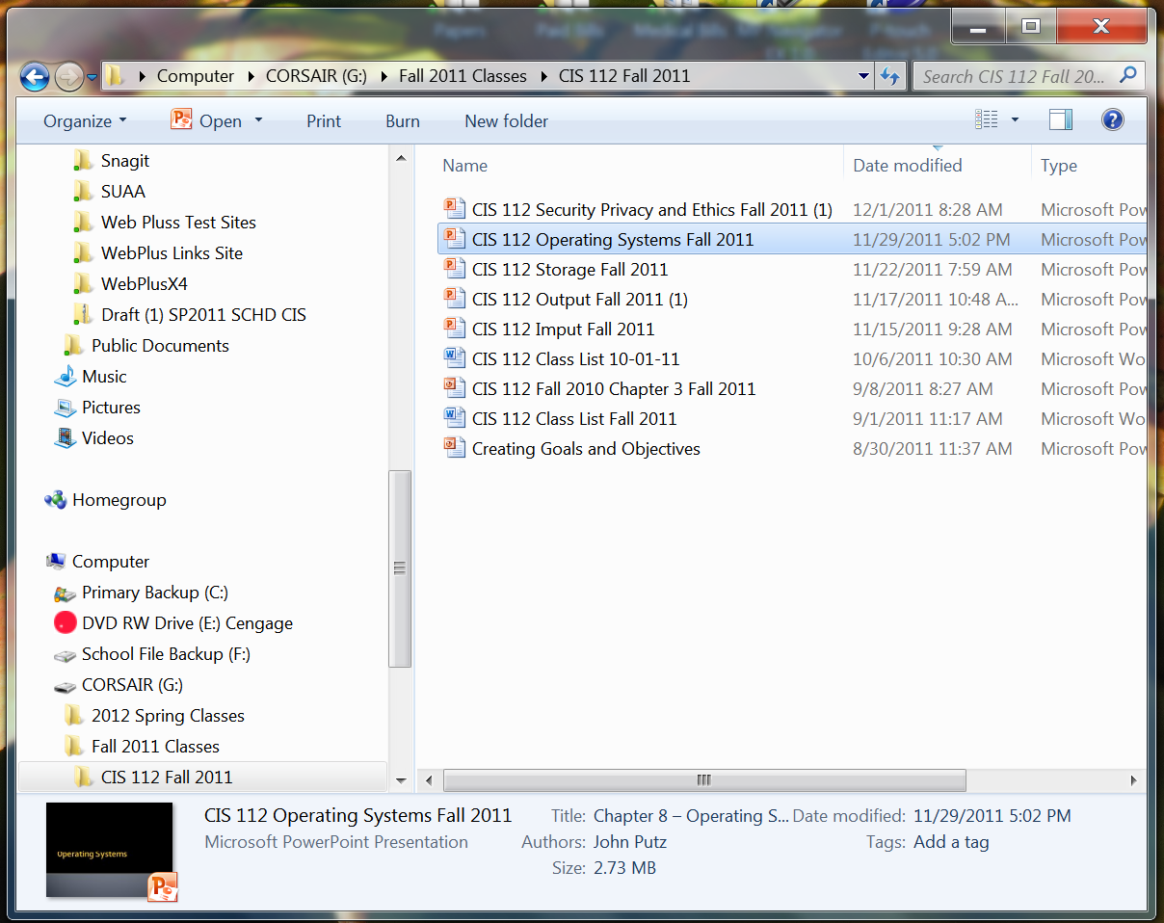
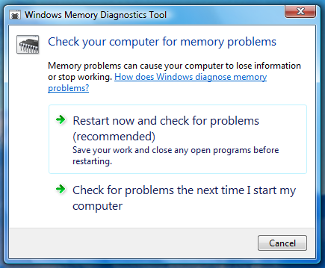
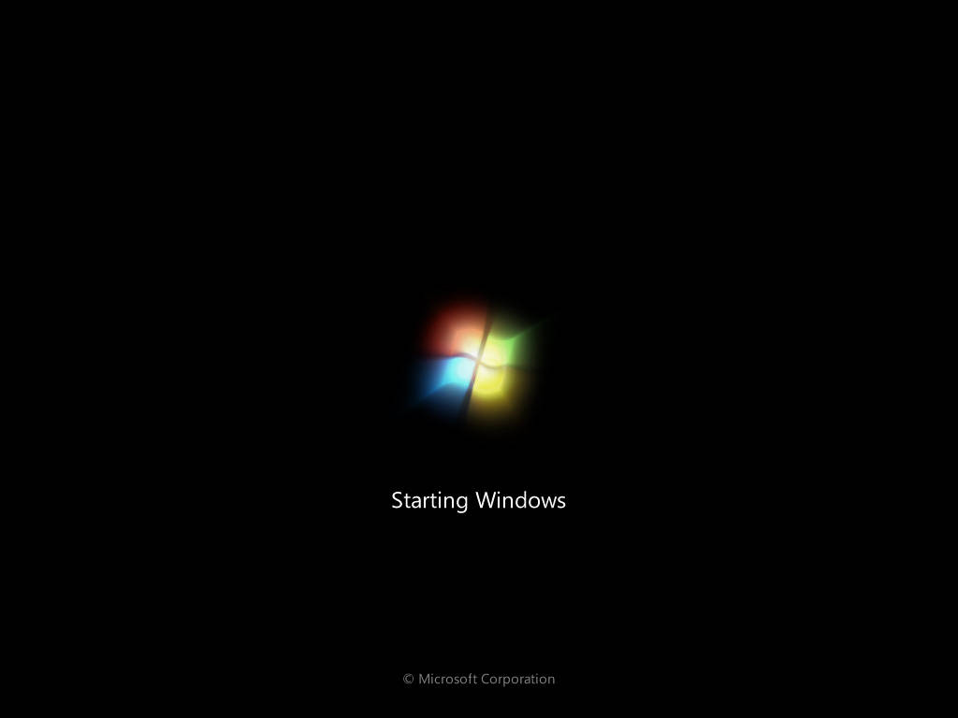
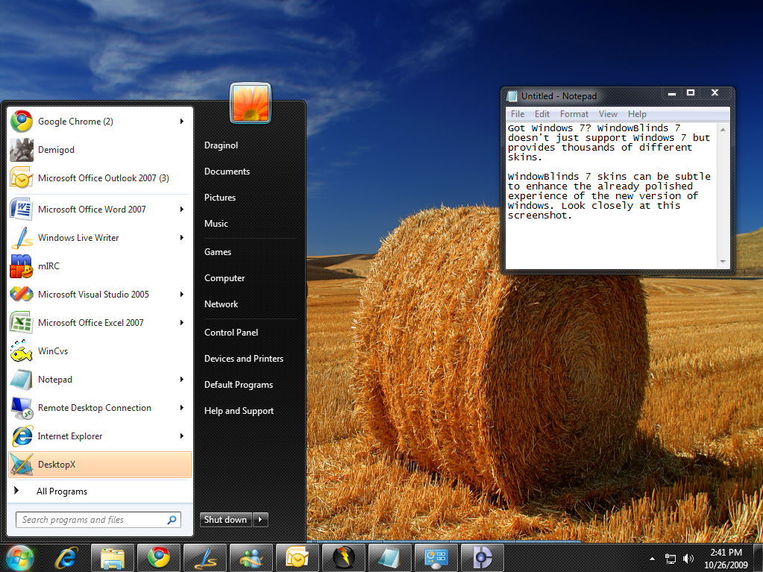
Operating System Functions
start up the computer
provide user interface
manage memory
schedule jobs and
configure devices
control a network
administer security
Provide file management and other utilities
monitor performance

Slide 5
Processing Techniques for Increased Efficiency
One way computers operate more efficiently is to multitask.
Operating systems that support multithreading have the ability to rotate between multiple threads.
If a computer has two or more CPUs, techniques that perform operations simultaneously are possible.
  Multiprocessing
  Parallel processing

Slide 6
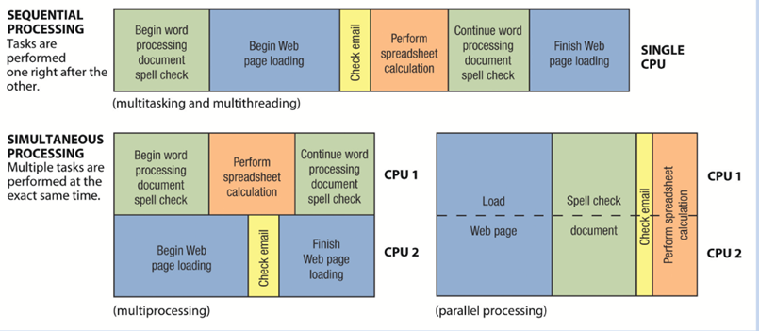
Processing Techniques for Increased Efficiency
Simultaneous vs. sequential processing

Slide 7
Processing Techniques for Increased Efficiency
Another key function of the operating system is memory management, which involves optimizing the use of main memory (RAM).
A buffer is an area in RAM or on the hard drive designated to hold input and output on their way into or out of the system.
The process of placing items in a buffer so they can be retrieved by the appropriate device when needed is called spooling.

Slide 8
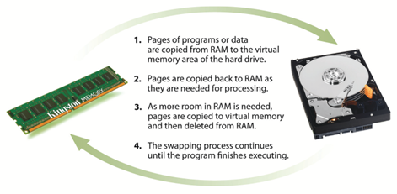
Processing Techniques for Increased Efficiency
Virtual memory (VM) management allocates portion of hard disk to function like RAM
This occurs when the amount of information that needs to be accessed by the CPU exceeds the amount of memory the PC contains.

Slide 9
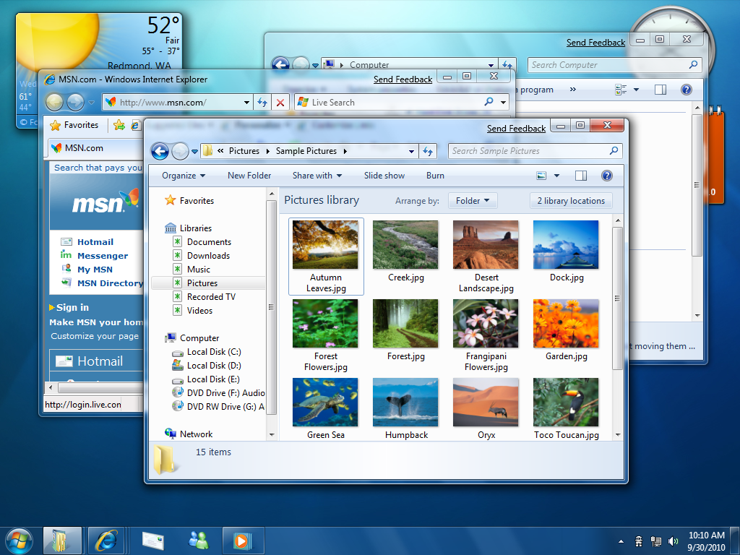
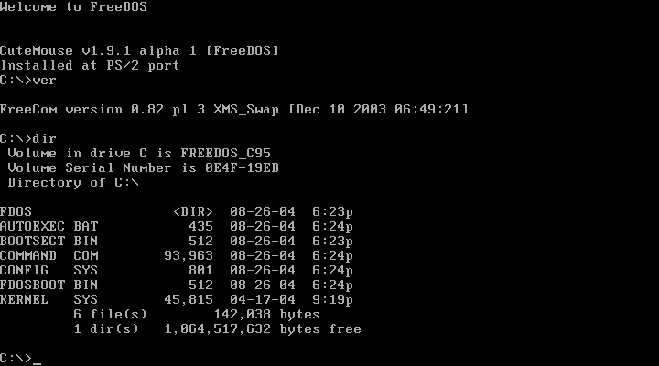
Differences Among Operating Systems
Most operating systems today use a graphical user interface (GUI), in which users can click icons or commands on the screen to issue instructions to the computer.
The older DOS operating system and some versions of the UNIX and Linux operating systems use a command line interface, which requires users to type commands to issue instructions to the computer.

Slide 10
Operating Systems – Configuring Hardware
When the OS starts up it must find and configure all of the hardware attached to the PC
It does this by using device drivers
This is a small program that tells the operating system how to configure and communicate with each peace of hardware.
Each device attached to a PC has a unique driver
These drivers are either found in the OS system or come with the hardware on a CD/DVD disk.

Slide 11
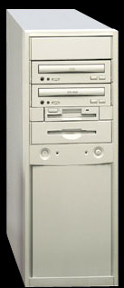
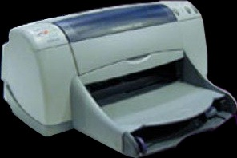
Operating System - Drivers
device driver

Slide 12
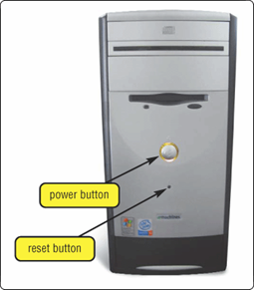
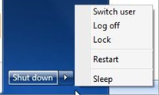
Operating System Start-up
cold boot
Process of turning on a computer after it has been powered off completely
warm boot
Process of restarting a computer that is already powered on

Slide 13
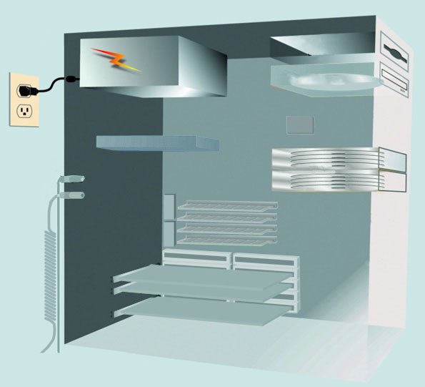
How a Desktop PC Boots
Step 1:
Power supply sends signal to components in system unit
Processor
Step 2:
The processor accesses BIOS to start computer
BIOS

Slide 14
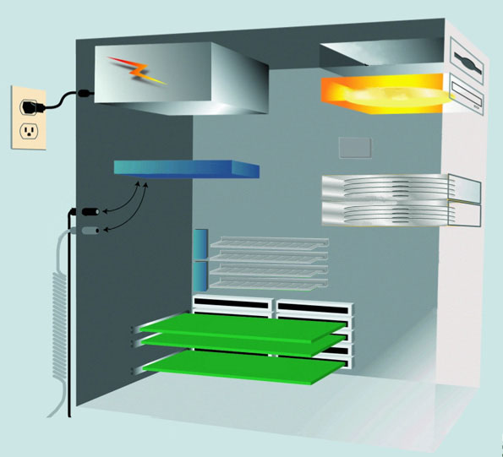
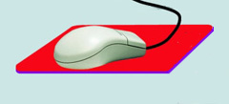
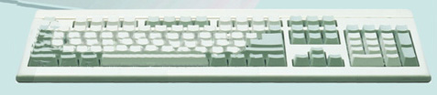
How a Desktop PC Boots
Step 3:
BIOS checks components such as mouse, keyboard connectors, and expansion cards
CD-ROM drive
processor
BIOS
expansion cards

Slide 15
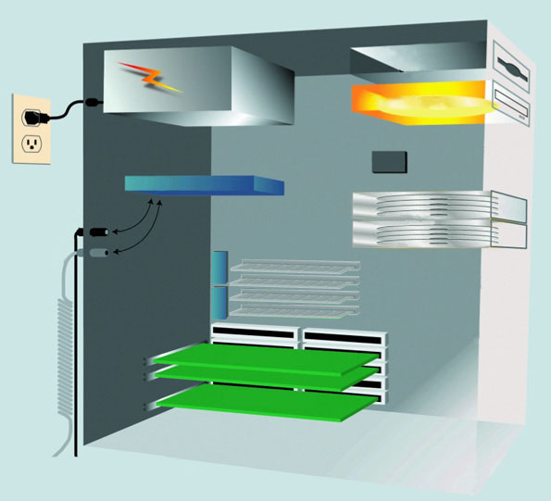
How a Desktop PC Boots
Step 4:
Results of POST are compared to data in the CMOS chip
CD-ROM drive
CMOS
processor
BIOS
expansion cards
expansion cards

Slide 16
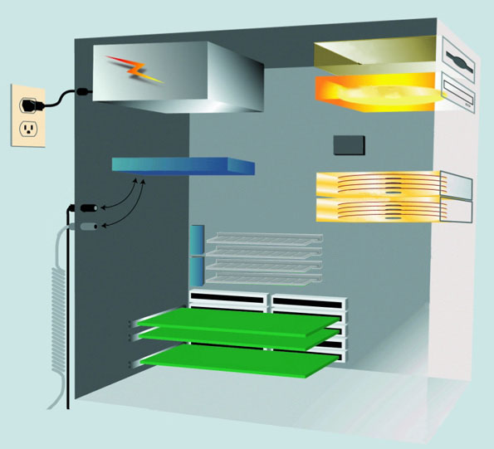
How a Desktop PC Boots
Step 5:
BIOS looks for system files in drive C (hard disk), can also look in the CD/DVD drive or USB drive
The drive that boots the computer is called the boot drive.
floppy disk drive
CD-ROM drive
CMOS
processor
hard disk
BIOS
expansion cards

Slide 17
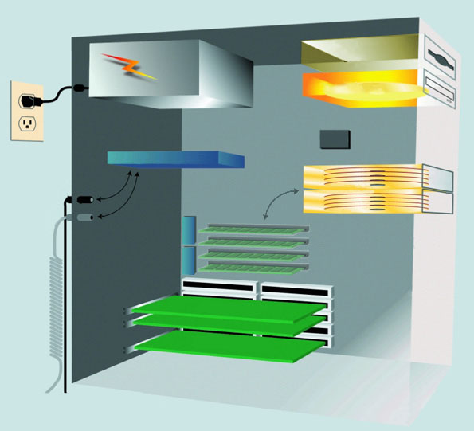
How a Desktop PC Boots
Step 6: Boot program loads kernel of operating system into RAM from boot drive
floppy disk drive
CD-ROM drive
CMOS
Operating system in memory takes control of computer
processor
hard disk
(RAM) memory modules
BIOS
Step 6
expansion cards

Slide 18
How a Desktop PC Boots
Step 7: Operating system loads configuration information and displays desktop on screen
Operating system executes programs in StartUp folder
click Start to display list of applications you can run

Slide 19
Differences Among Operating Systems
Types of Operating Systems:
  Personal operating systems (desktop operating systems)
  Server operating systems (network operating systems)
  Mobile operating systems
  Embedded operating systems

Slide 20
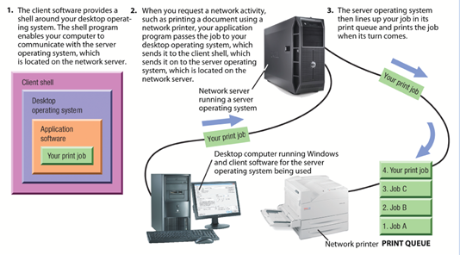
Differences Among Operating Systems
How operating systems are used in a network environment

Slide 21
Operating Systems for Desktop PCs
Topics Covered:
  Windows
  Windows Server and Windows Home Server
  Mac OS and Mac OS X Server
  Unix
  Linux

Slide 22
Windows
Microsoft created the original version of Windows (Windows 1.0) in 1985 in an effort to meet the eeds of users frustrated by having to learn and use DOS commands.
Other versions of Windows included:
  Windows 95 & Windows 98: GUI similar to Windows 3.x but supported multitasking, customization, etc.
  Windows NT: first 32-bit version of Windows
  Windows Vista: available in 32-bit and 64-bit versions
  Windows 7
  Windows 8

Slide 23
Windows Server and Windows Home Server
Windows Server is the version of Windows designed for server use.
Windows Server 2008 includes:
  Internet Information Services 7.0, which is a powerful Web platform for Web applications and Web services
  Built-in virtualization technologies
  A variety of new security tools and enhancements
  Streamlined configuration and management tools

Slide 24
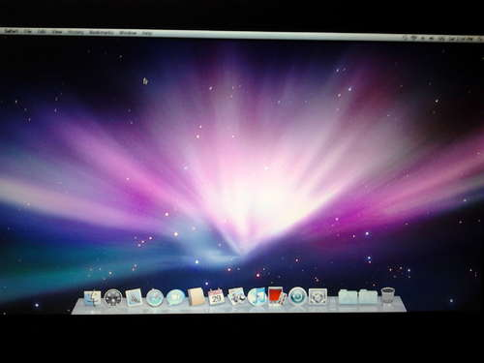
Mac OS and Mac OS X Server
Mac OS is the proprietary operating system for computers made by Apple Inc.
Mac OS X Server is the server version of Mac OS X.

Slide 25
UNIX
UNIX was developed in the late 1960s at AT&T Bell Laboratories as an operating system for midrange servers.
UNIX is a multiuser, multitasking operating system.
Computer systems ranging from microcomputers to mainframes can run UNIX, and it can support a variety of devices from different manufacturers.

Slide 26
Linux
Linux is an operating system developed by Linus Torvalds in 1991 when he was a student at the University of Helsinki in Finland.
Linux was released to the public as open source software; that is, a program whose source code is available to the public and can be modified to improve it or to customize it to a particular application.

Slide 27
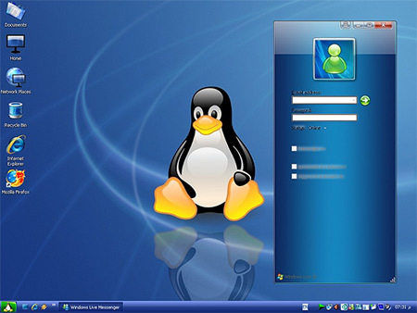
Linux

Slide 28
Operating Systems for Handheld PCs and Larger Computer
Topics Covered:
  Mobile and Embedded Versions of Windows
  Mobile Phone Operating Systems
  Operating Systems for Larger Computers

Slide 29
Mobile and Embedded Versions of Windows
Windows Mobile is the version of Windows designed for mobile phones.
Windows Embedded is a family of operating systems based on Windows that is designed primarily for consumer and industrial devices that are not personal computers, such as cash registers, digital photo frames, GPS devices, ATMs, medical devices, and robots.

Slide 30
Mobile Phone Operating Systems
Android: Linux-based that supports multitasking
iPhone OS: designed for Apple mobile phones and mobile devices
BlackBerry OS: designed for BlackBerry devices
Palm OS: original operating system designed for Pam devices
  Palm webOS: Linux-based, designed for next-generation Pam mobile phones
Symbian OS: supports multithreading and multitasking
Embedded Linux: an operating system alternative for mobile phones, GPS devices, portable digital media players, and other mobile devices

Slide 31
Operating Systems for Larger Computers
Larger computer systems—such as high-end servers, mainframes, and supercomputers—sometimes use operating systems designed solely for that type of system.
Larger computer systems may also use a customized operating system based on a conventional operating system.
  Such as AIX or UNICOS

Slide 32
Utility Programs
A system software that allows the user to perform maintenance type tasks including
  Managing the computer
  Its device
  Its programs

Slide 33
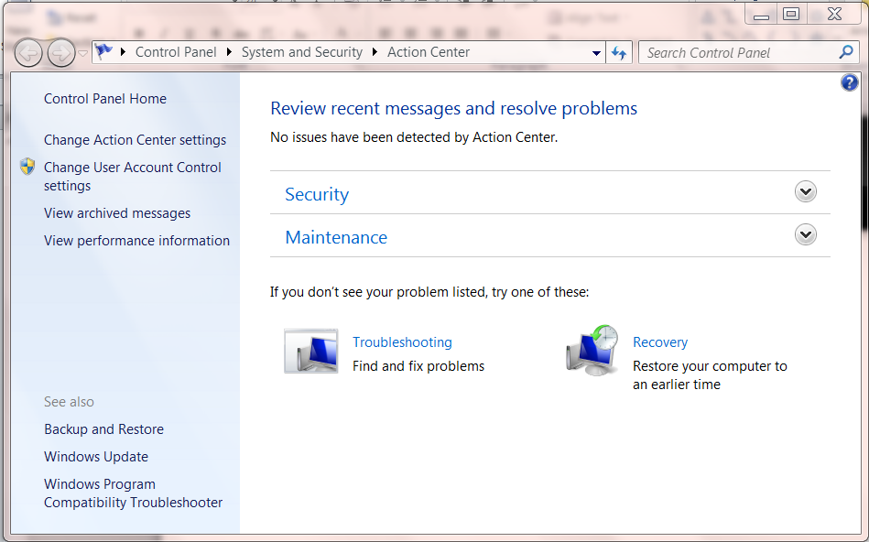
Command Center
Provides status information on;
  Security
  Updates
  Maintenance
  Troubleshooting

Slide 34
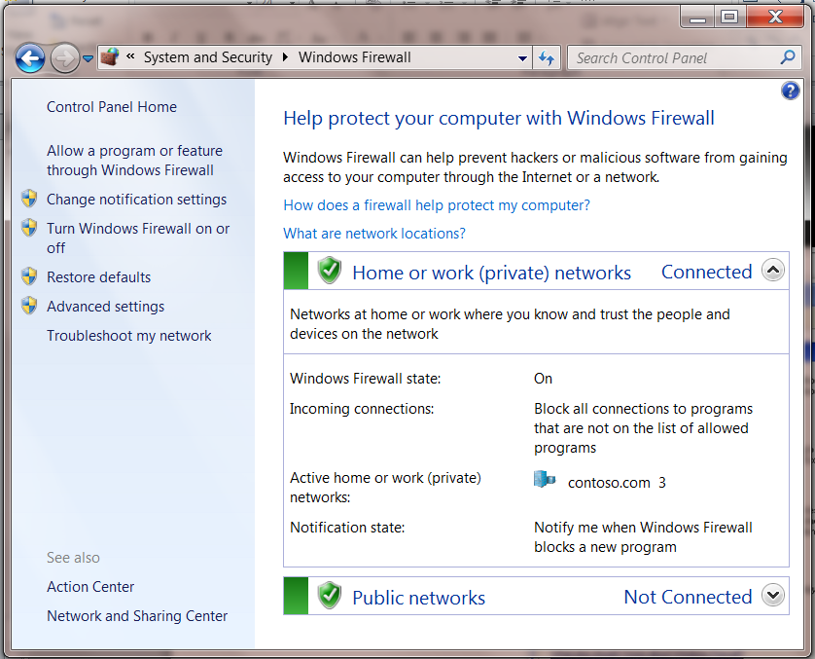
Firewall
Detects and protects a computer from unauthorized intrusions

Slide 35
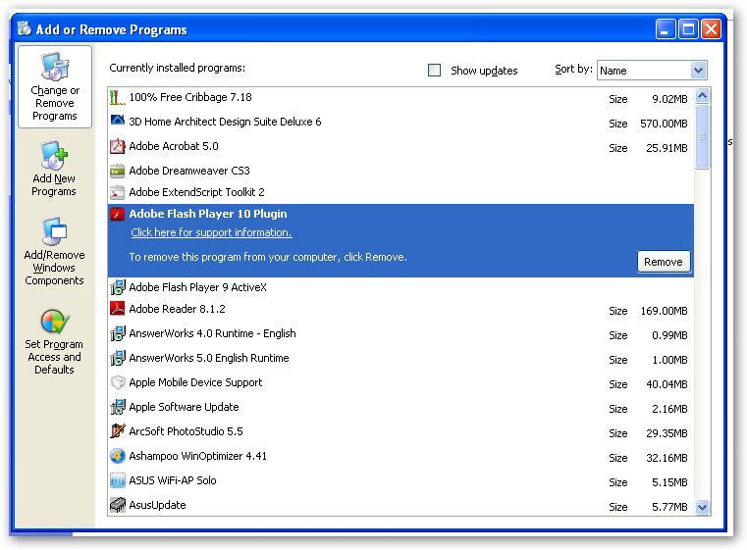
Uninstaller
Removes programs from the operating system.

Slide 36
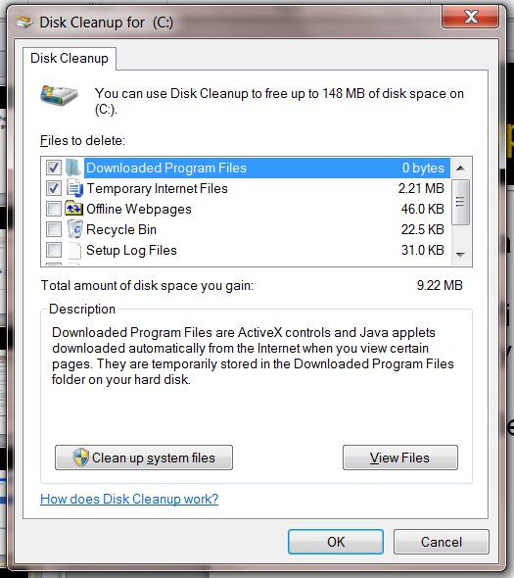
Disk Cleanup
A program that scans for unnecessary files
It then gives you the option to remove the files.

Slide 37
Disk Fragmantation
When a hard drive is new files are stored in sequential blocks of data.
When files are deleted space is opened up on the hard drive
When new files are saved the bocks they contain fill in the hard drive starting from the front of the drive.
The new files is now fragmented on the hard drive

Slide 38
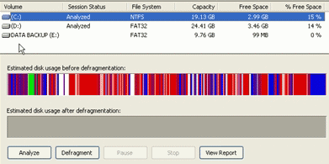
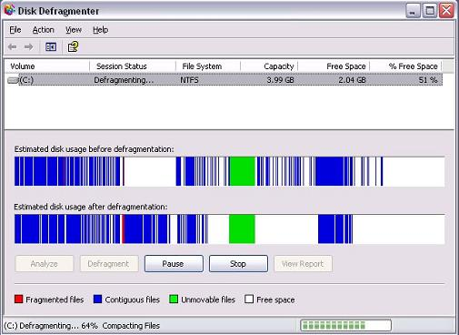
Disk Fragmantation
Over time the hard drive on a computer becomes extremely fragmented.
This will effect the speed at which the computer will work
To correct this problem you must defragment the hard drive.

Slide 39
Disk Defragmenter
In Windows 7 this is a scheduled process that occurs once a week.

Slide 40
Backing Up Your Data
There are many ways to back up your data
  You can copy it to a CD/DVD or Blue ray disk.
  You can copy it to an another internal hard drive
  You can copy it to an external hard drive.
  You can copy it to an Internet (cloud) hard drive.
How ever you do it, backing up your data should be a regular habit.

Slide 41
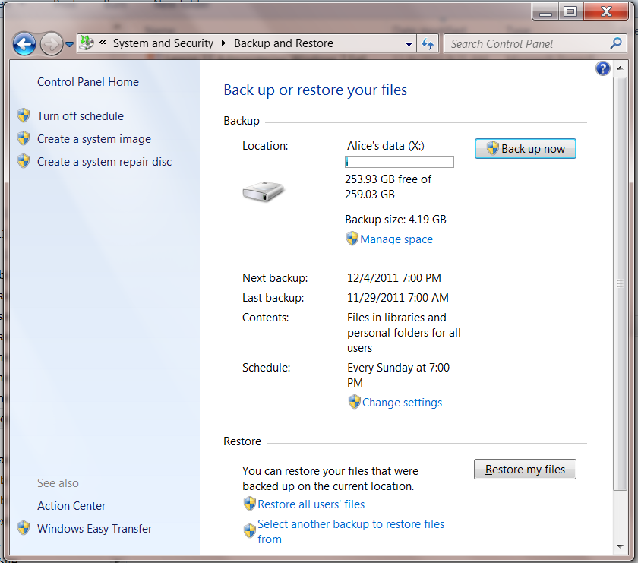
Backing Up Your Data
Backup utility programs
  Windows Backup utility
  Cloud Drives

